Slide 1
SMART IRRIGATION LAKE MANAGEMENT BY FAIR MAINTENANCE COST PREDICTION USING AI AND MACHINE LEARNING METHODS
TEAM CODEX[31]
M R KAVIN SARAN M.ESHWAR DIVIJ KP

Slide 2
PROBLEM STATEMENT
Poor water bodies maintenance results in flooding, erosion , excessive repair costs and water scarcity which affects the farmers indirectly.
Governments face financial losses due to inefficient irrigation Lakes management & tender corruption.
Overpricing in infrastructure projects leads to misallocation of public funds.
Unpredictable Costs in Sustainable Lake Management

Slide 3
PROPOSED SOLUTION
An AI -driven system for monitoring irrigating lakes, analyzing tenders, and optimizing costs.
Real-time lakecondition tracking using characteristic inputs & historical data analysis.
Tender cost prediction by comparing with historical pricing to flag anomalies.
Flood prevention through predictive analysis of water inflow.

Slide 4
KEY FEATURES & IMPLEMENTATION
Find target dimensions using inflow data
Calculate the condition of the lake using rate of sedimentation and erosion
Fair tender cost prediction using the lake condition and inflow as parameters and material cost as constant entry

Slide 5
IMPACT & BENEFITS
Prevents Government Resource Loss
Misuse of government funds results in inadequate resources for essential projects.
Optimizes Infrastructure Spending
Improves water availability in scarce areas

Slide 6
TECH STACK & FUTURE SCOPE
Frontend: sceramlit
Backend: CSV(for data storage)
AI Model: Scikit-learn (Random Forest Regressor)
Sensors: lidar(3-D BATHYMETRIC MAP)
Image Processing: OpenCV (for lake area estimation)

Slide 7
NOVELTY
🔹 Dynamic Target Depth Calculation based on inflow capacity (m³/month)
🔹 AI Model Stability – Consistent predictions, avoiding random fluctuations
🔹 Fair Tender Price Prediction – Ensures transparency & optimized budgeting
🔹 Image Processing for Area Estimation – Automates surface area detection using OpenCV.

Slide 8
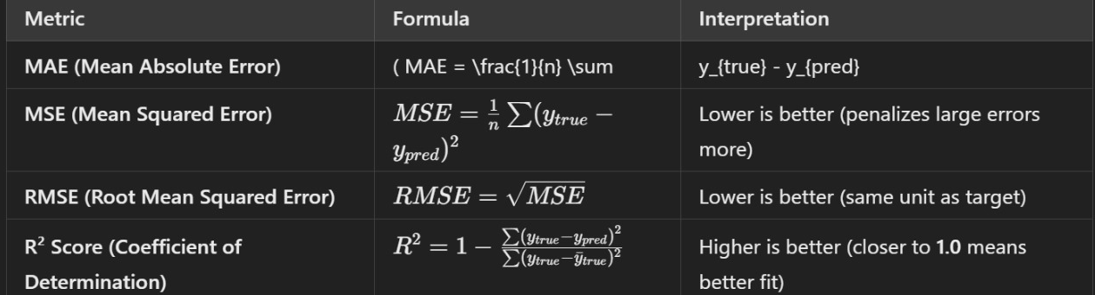
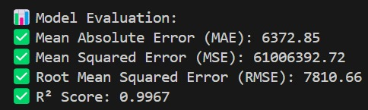
EFFICENCY & METRIC

Slide 9
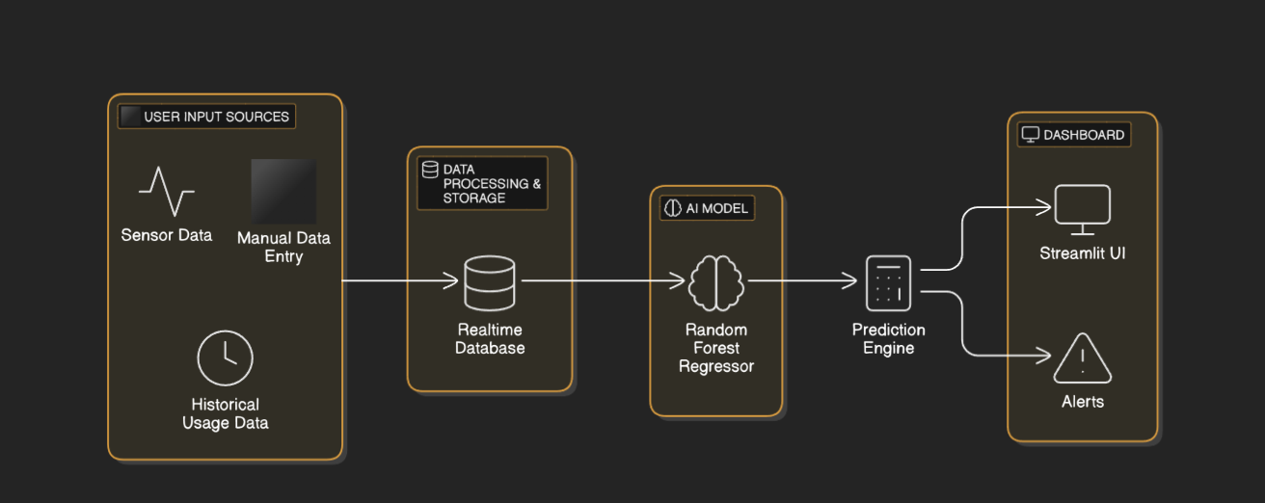
SYSTEM ARECHITECTURE

Slide 10
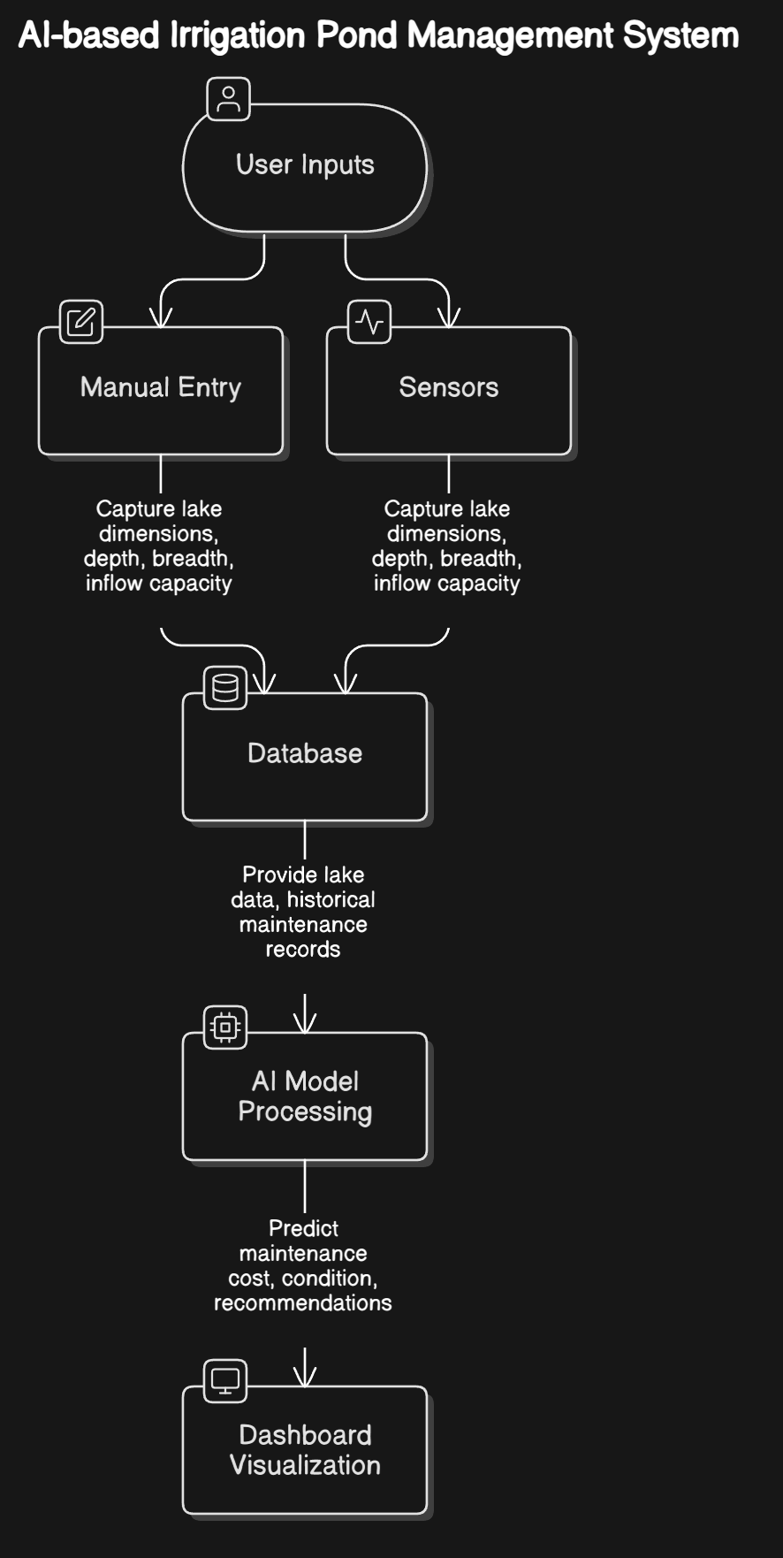
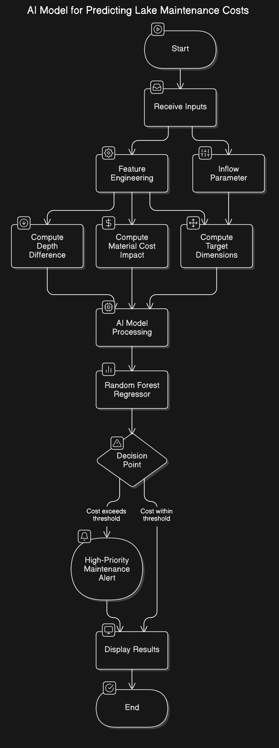

Slide 11
THANK YOU

